Slide 1
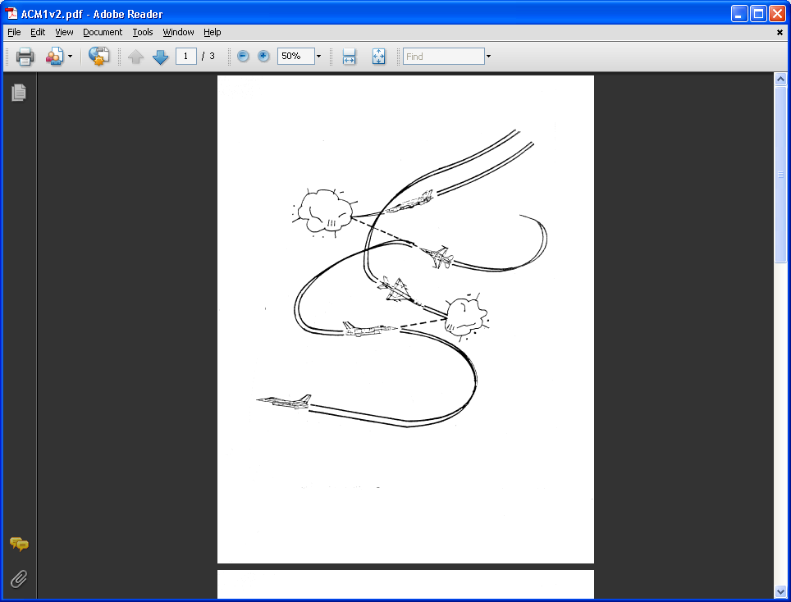
AE 317 Flight Mechanics and Performance
Thrust Available, Thrust Required, and Effects
LECTURE 12
Dr. Jeff Ashworth
Aerospace Engineering Department

Slide 2
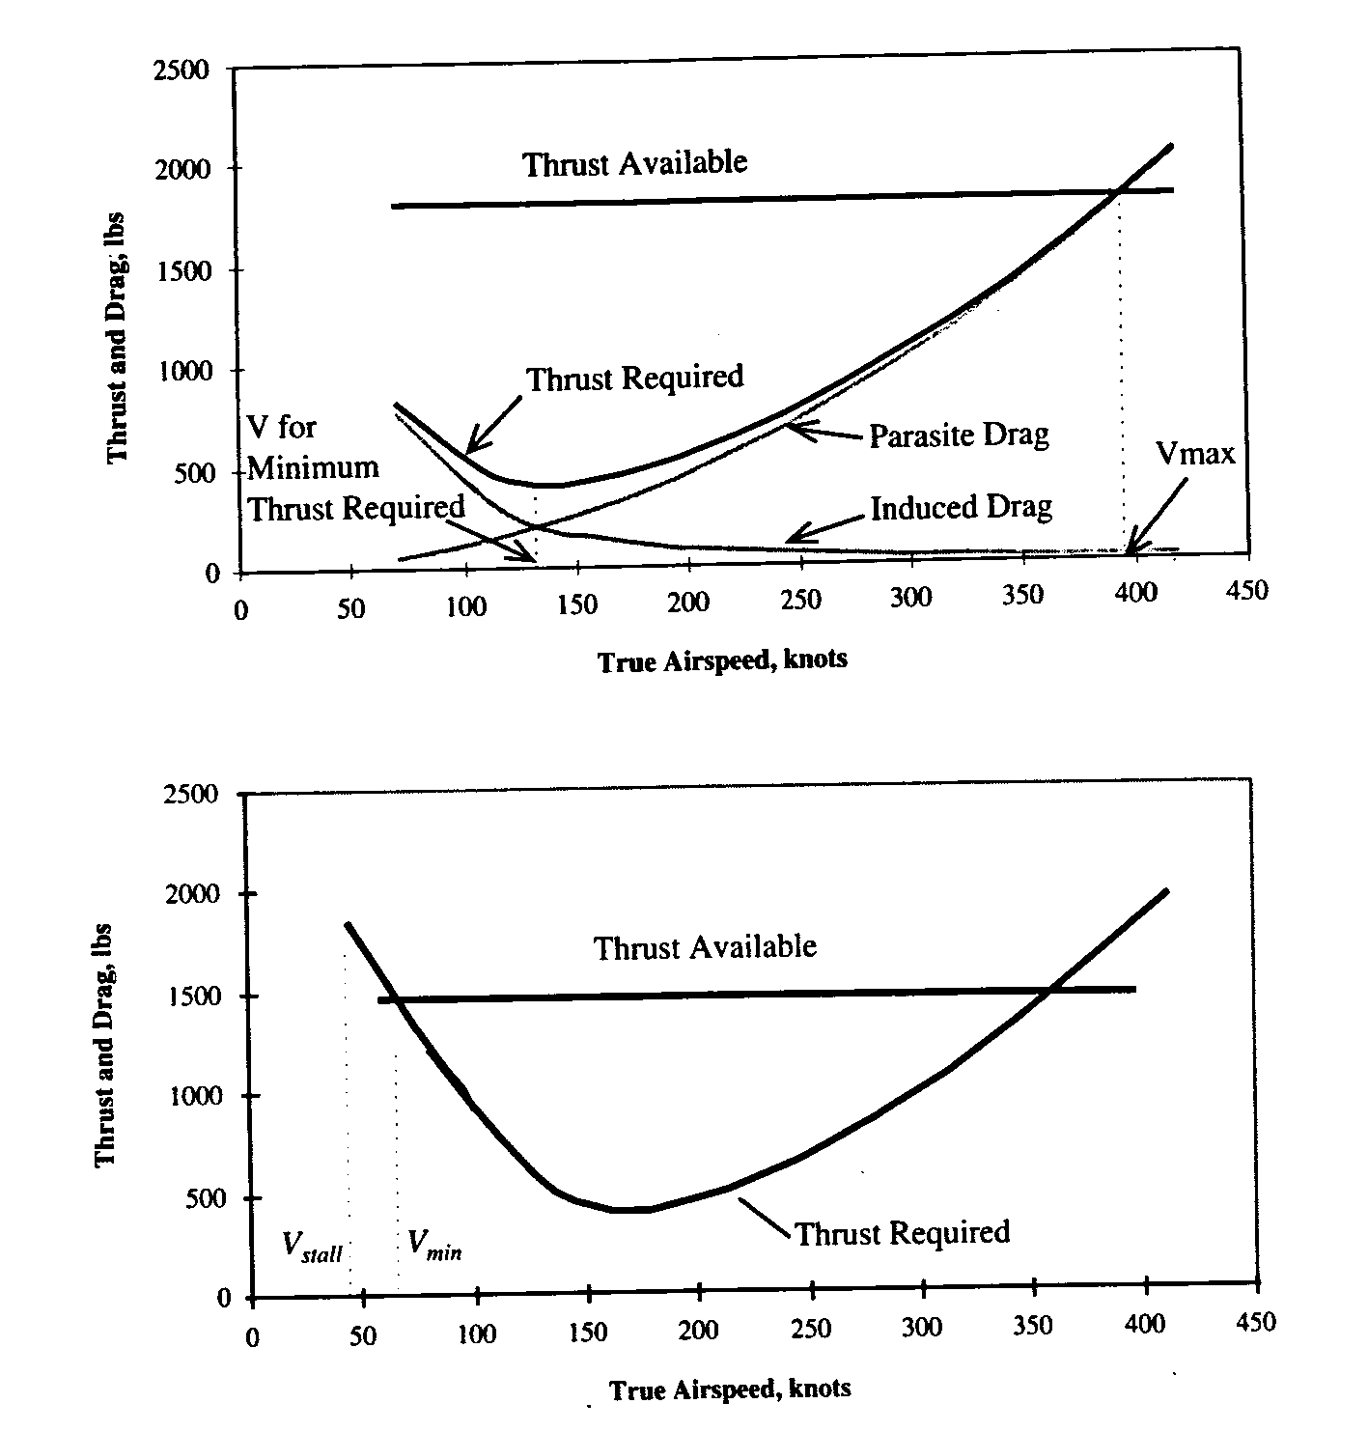
(Brandt)

Slide 3
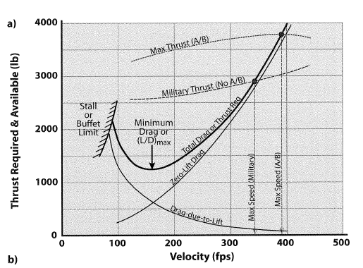
(Nicolai/Carichner)

Slide 4
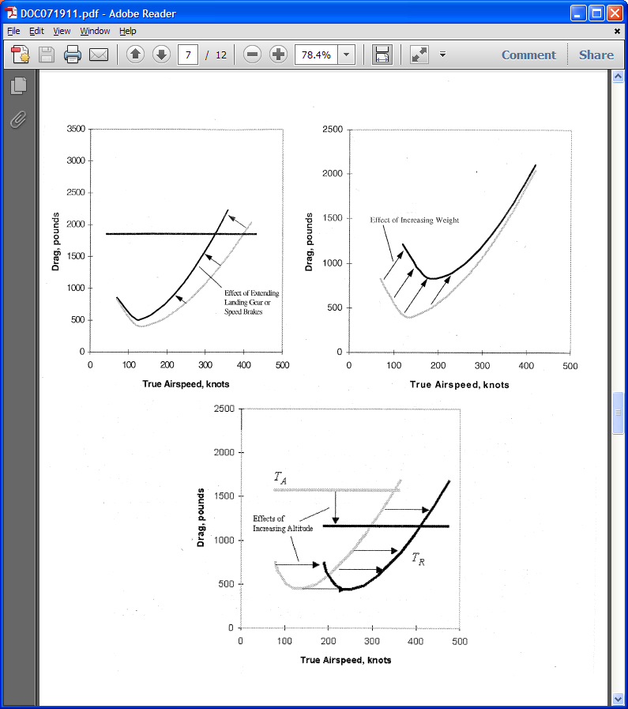
(Brandt)

Slide 5
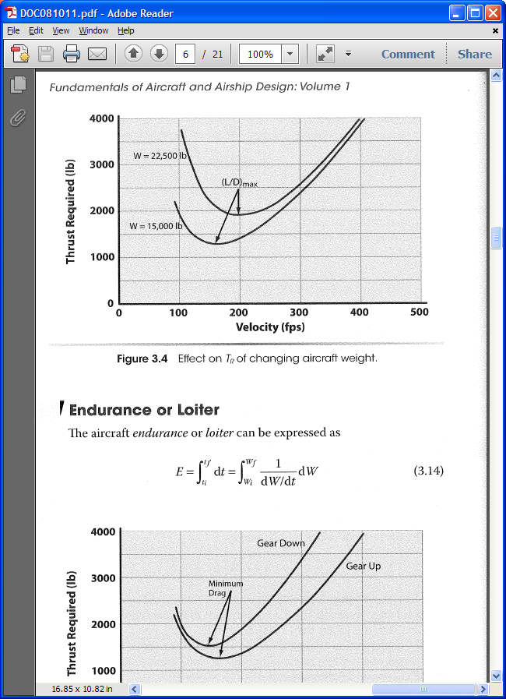
(Nicolai/Carichner)

Slide 6
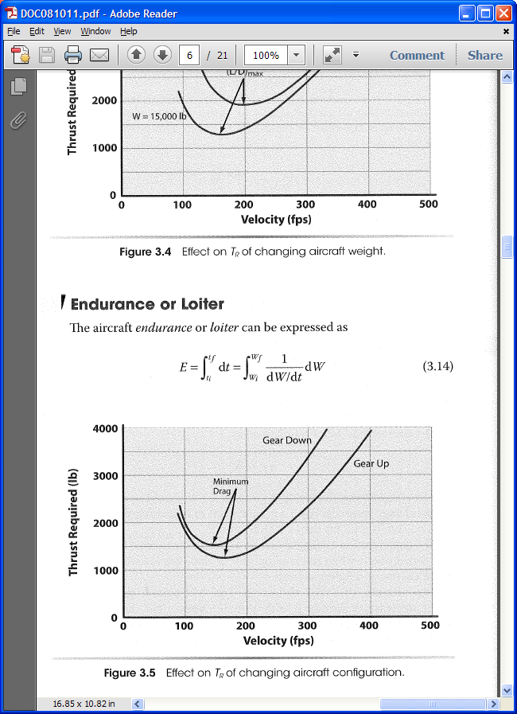
(Nicolai/Carichner)

Slide 7
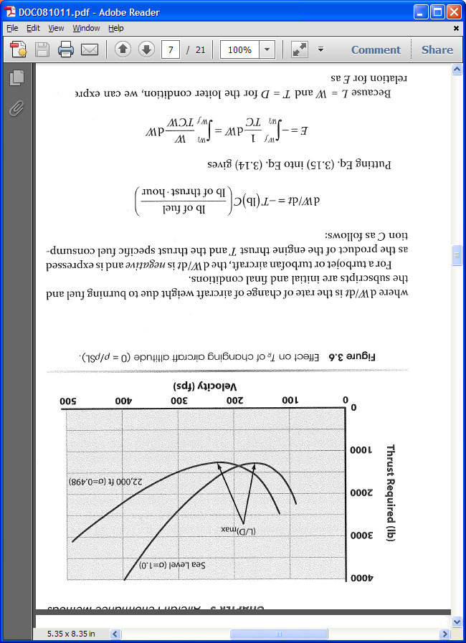
(Nicolai/Carichner)

Slide 8
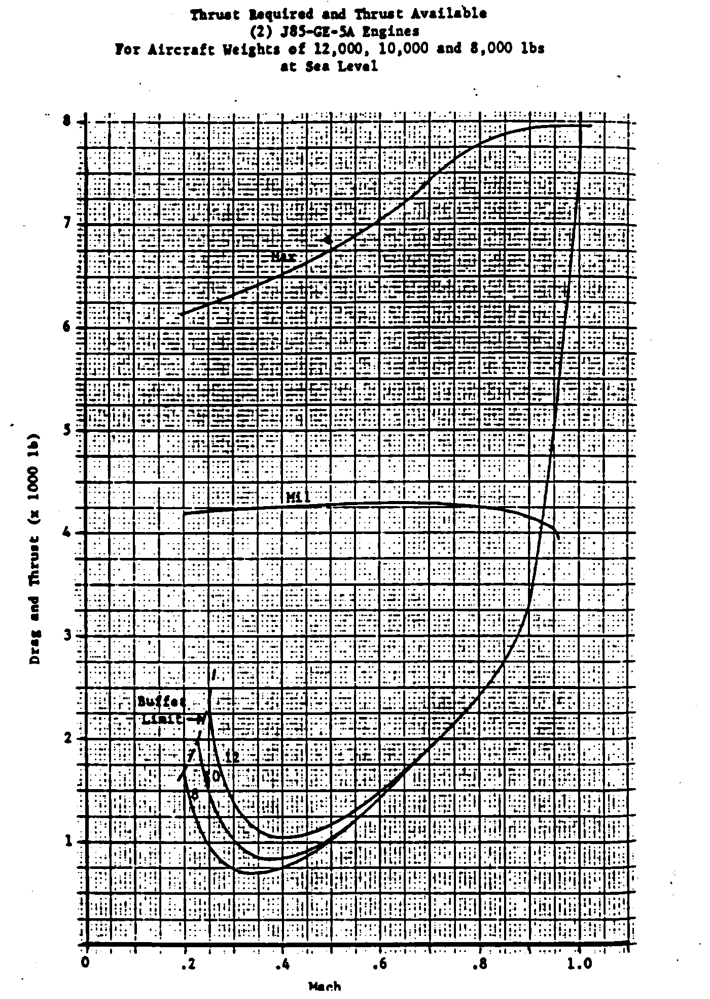
(Brandt)

Slide 9
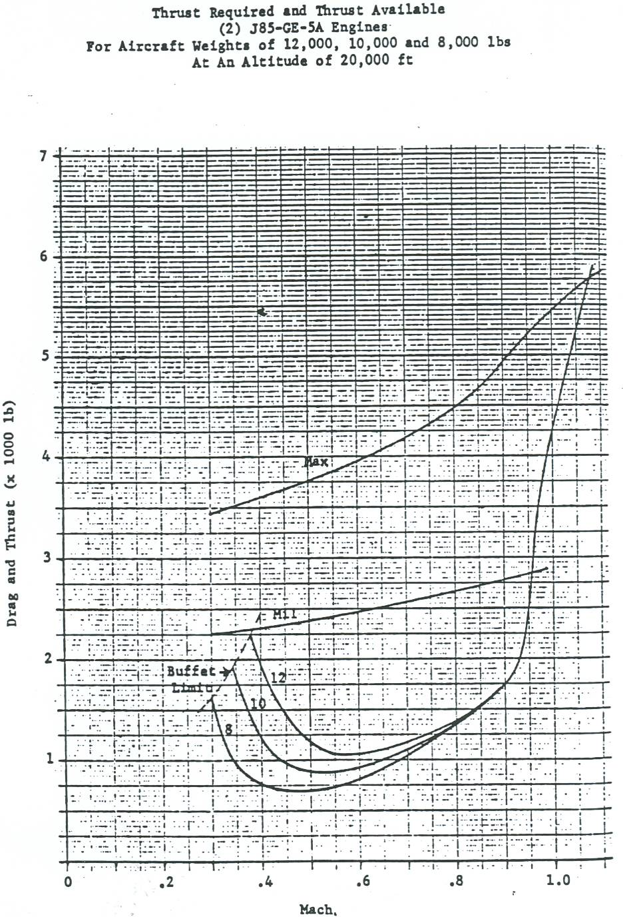
(Brandt)

Slide 10
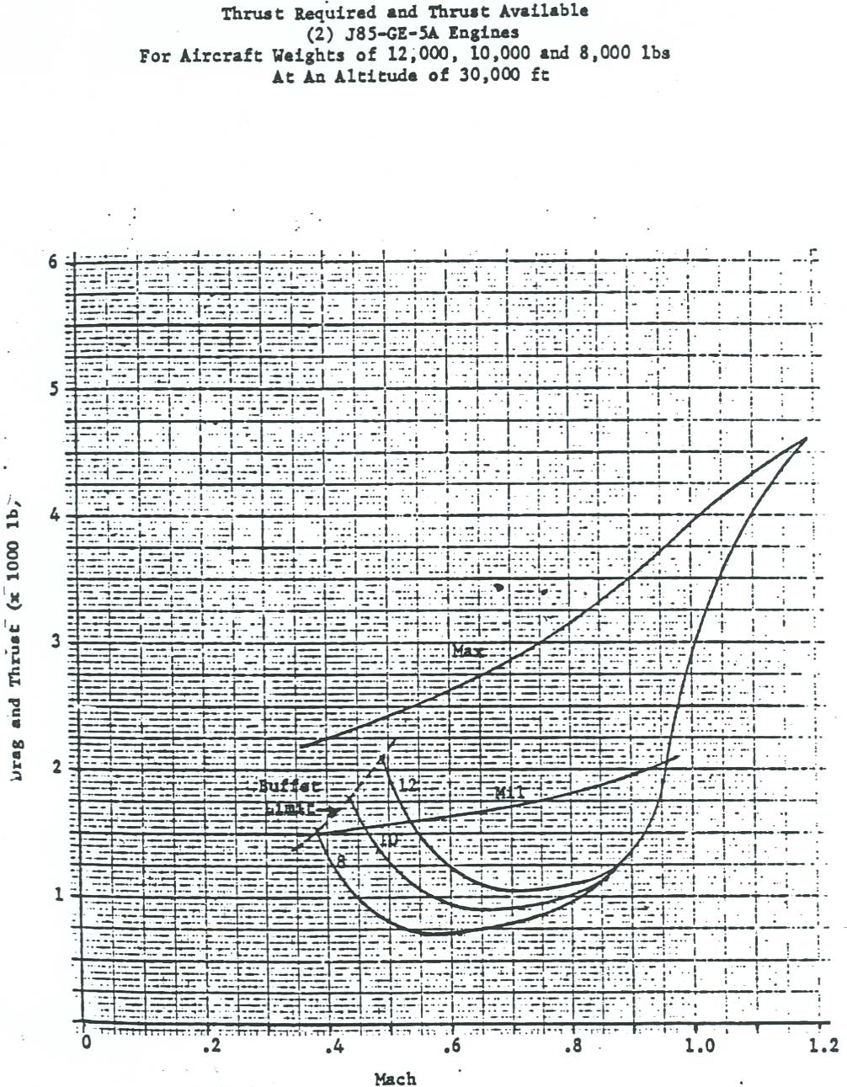
(Brandt)

